Slide 1

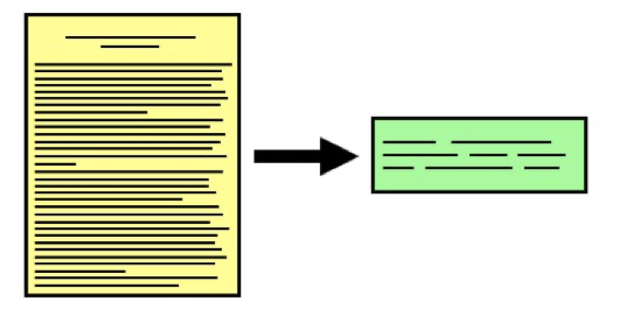
Summarization I
Presented By: Ameet Deshpande
March 24, 2020

Slide 2
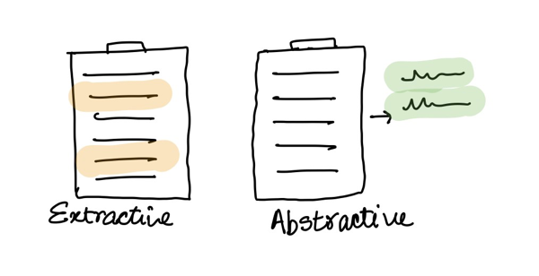


TASK
Text Summarization is the reduction of data to a (minimal) subset which represents the original data
Two types of Summarization techniques
Notes:
Extractive is like how we answer Pre-Lecture questions

Slide 3
Extractive Summarization
The Piston Cup drew large crowds, like it always does.
The defending champion Lightning McQueen emerged victorious yet again.
Following the win, Dinoco offered a new sponsorship deal which he declined.
He says he will be spending the next few weeks with his friends in Radiator Springs.
Intermediate Representation
Score the sentences
Select the sentences
[Allahyari et al., 2017]

Slide 4
Abstractive summarization
Paraphrasing
Generalization
Inference
Real-World Knowledge
Notes:
Advantages of

Slide 5
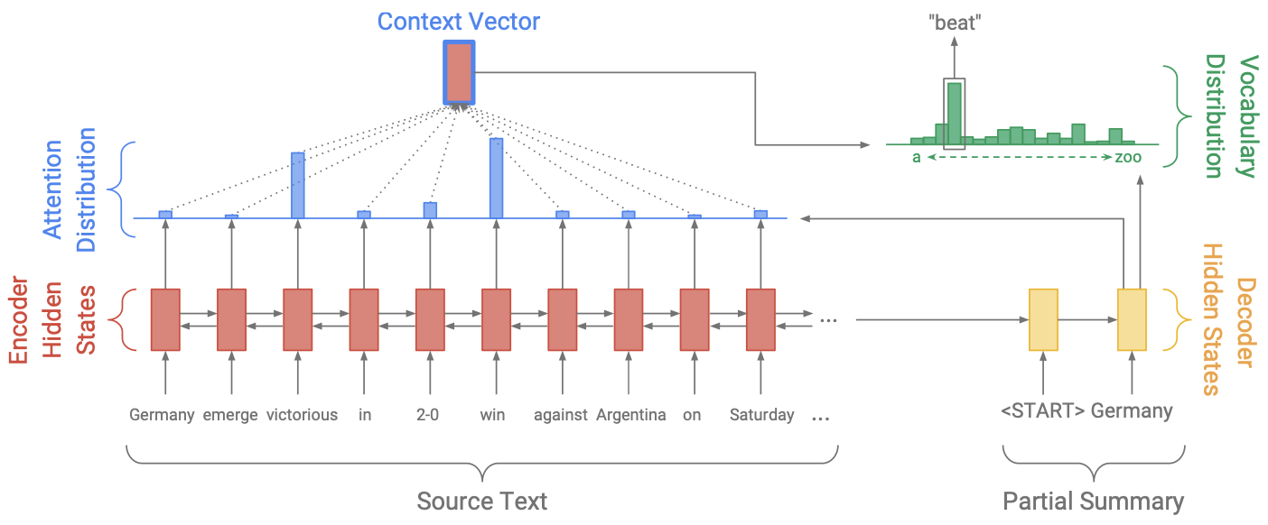
Seq2Seq for summarization
[Rush et al., 2015]: Use attention mechanism along with a seq2seq model
[chopra et al., 2016]: Use convolutional attention
[nallapati et al., 2016]: State of the art for extractive techniques

Slide 6
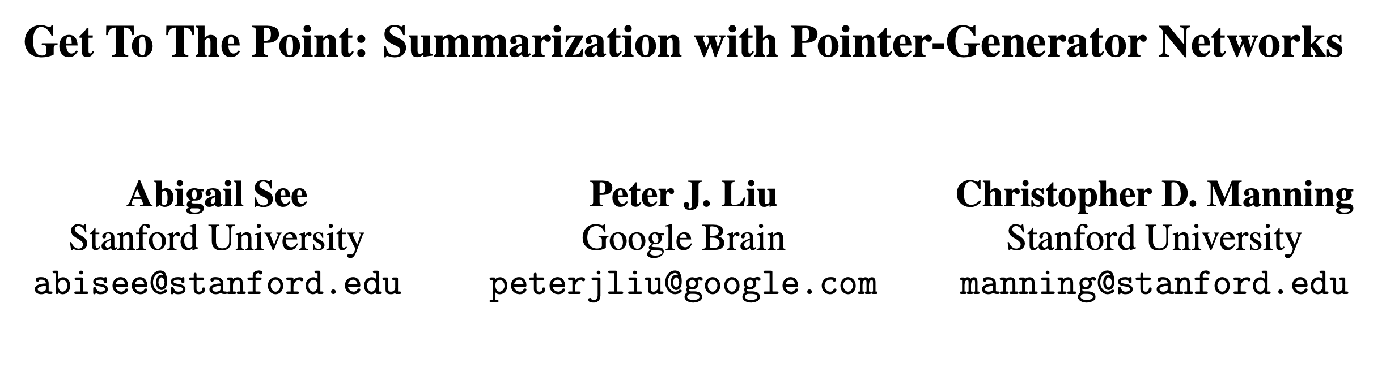
First Paper
[See et al., 2017]

Slide 7
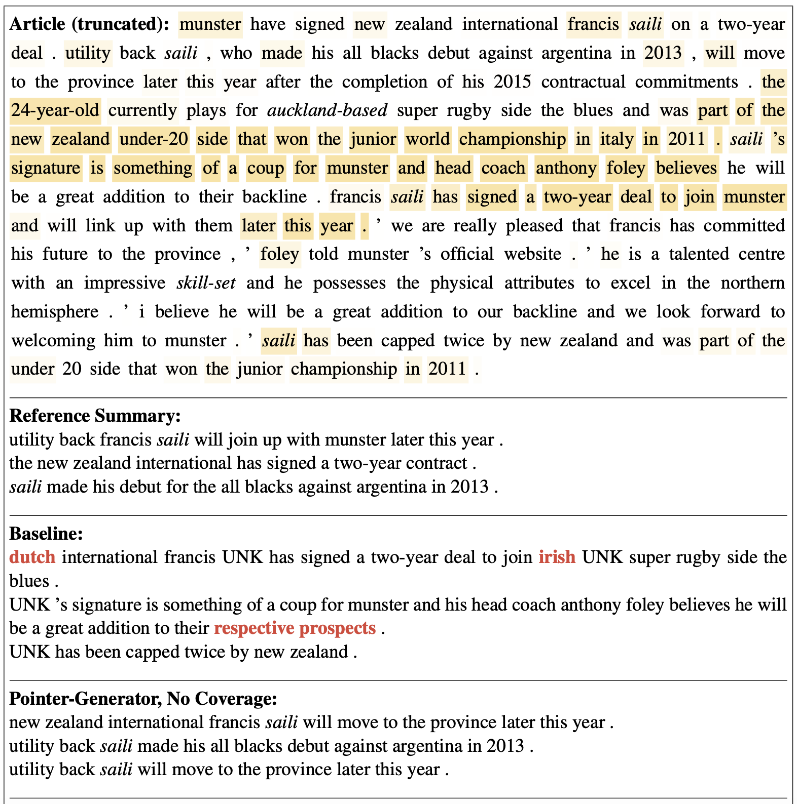
AIM of the paper
Factual Errors and UNK
Repetition
Notes:
Gender Bias, Words with higher frequency

Slide 8
Baseline: Sequence To Sequence
Context Vector
"beat"
Vocabulary Distribution
weighted sum
weighted sum
Attention Distribution
a
zoo
Encoder Hidden States
...
Decoder Hidden States
Germany emerge victorious in 2-0 win against Argentina on Saturday ...
<START>
Germany
Source Text
Partial Summary

Slide 9
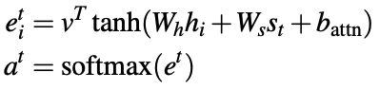
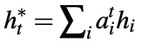
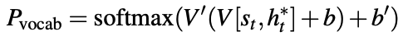
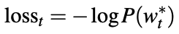

Slide 10
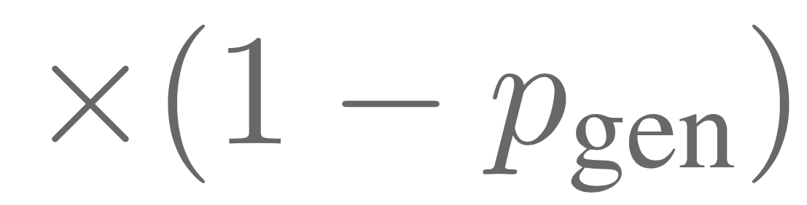

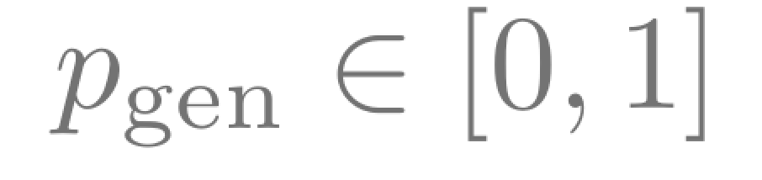
Pointer-Generator Network
Final Distribution
"Argentina"
"2-0"
a
zoo
Context Vector
Vocabulary Distribution
a
zoo
Attention Distribution
...
Decoder Hidden States
Germany emerge victorious in 2-0 win against Argentina on Saturday ...
<START>
Germany
beat

Slide 11
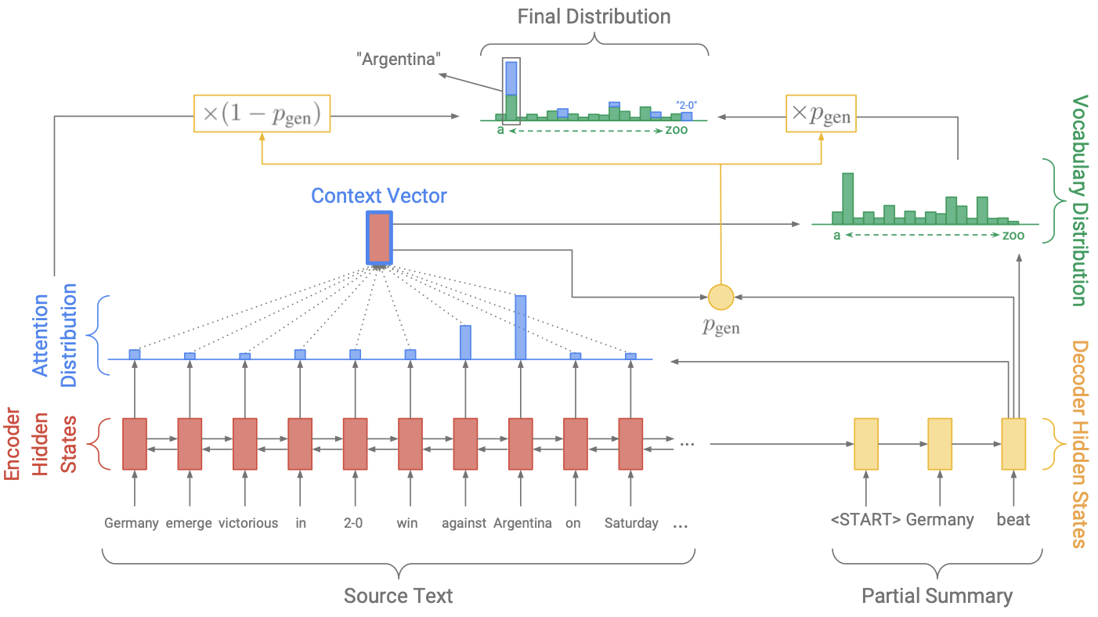
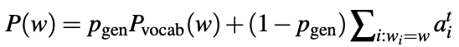
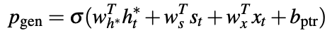
Equations will appear here. Also mention that only 1153 parameters are added

Slide 12
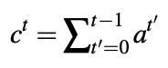
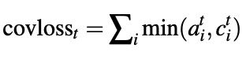
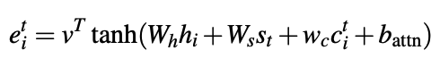
Coverage Mechanism
Notes:
Explain that they already had this in Machine Translation covloss: When the coverage vector is 0, no penalty when things are being attended to.

Slide 13
NOVELTY
The generation probability is explicitly calculated
The attention Distribution is used as the copy distribution
Coverage Mechanism had not been used for summarization

Slide 14


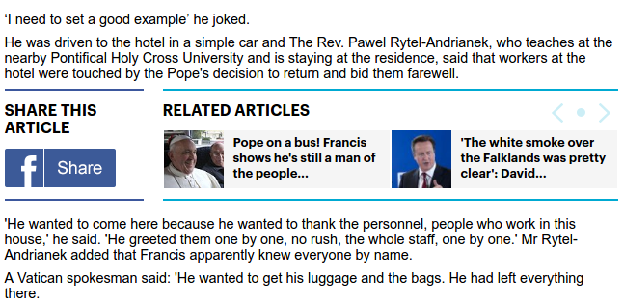
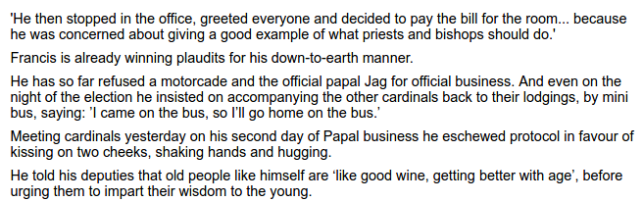
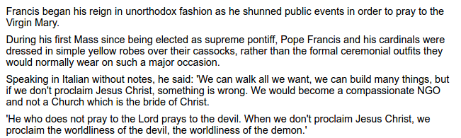
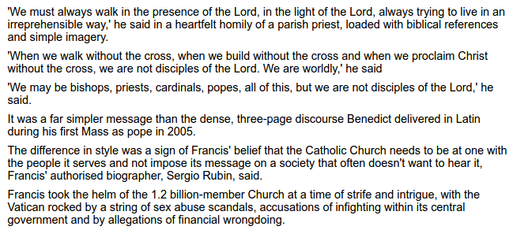
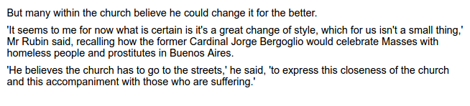
CNN / Daily Mail dataset
Long news articles (average ~800 words)
Multi-sentence summaries (usually 3 or 4 sentences)
Summary contains information from throughout the article
Non-Anonymized version is used
[Hermann et al., 2015]

Slide 15
Design choices
Smaller Vocabulary is used because the network can explicitly copy
The documents are truncated to 400 tokens
The lengths of the documents is even smaller when training begins
The coverage loss is only added at the end of the training

Slide 16


Evaluation Metrics - Example
A cat rested on the red mat
A kitten sat on the mat which was red in color
Candidate
$$\frac{5}{7}$$
Precision:
$$\frac{5}{11}$$
Recall:
Reference

Slide 17
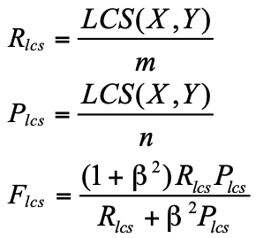
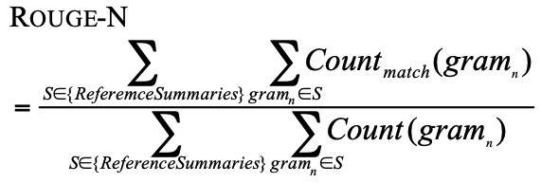
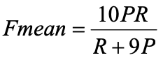
Evaluation Metrics
ROUGE-1
ROUGE-2
ROUGE-L
METEOR

Slide 18
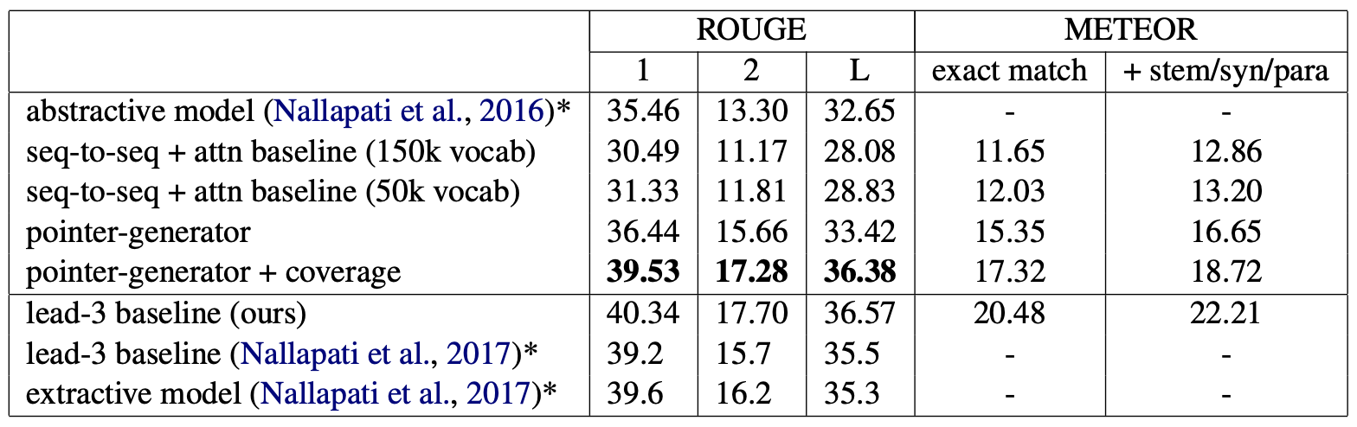
Results

Slide 19
Losing to extractive systems
Most important information in a news article is at the beginning
The metrics are not very conducive for abstractive models
Even though the reference summaries deviate from the original vocabulary, this is usually in an unpredictable manner. So extractive and abstractive models have equal probability of getting this right
Notes:
Mention that this is why it makes sense to take only the first 400 words of the article

Slide 20
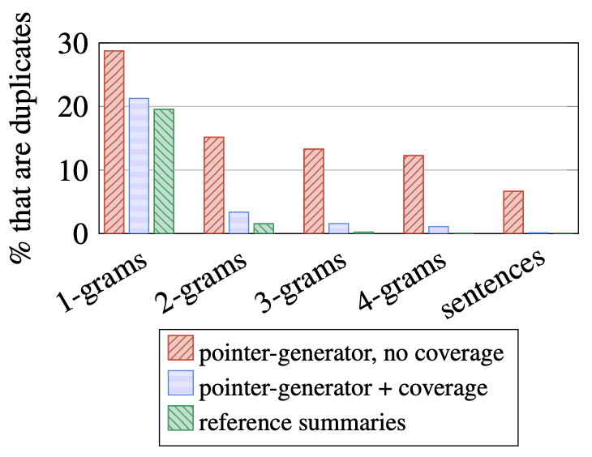
Observations
Baseline model
Factual errors
Rare words are replaced with more common words
Repetition
Pointer-Generator
Solves the above problems, but repetition is still common
Coverage Mechanism
Repetition is almost eliminated, even though this is only 1% of the training time

Slide 21
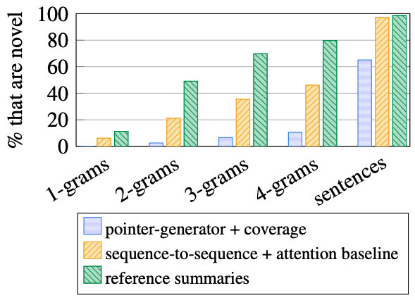
How abstractive are the models?
N-Gram Overlap
Whole article sentences are copied 35% of the times
P_gen changes from 0.30 to 0.53
P_gen during testing is 0.17

Slide 22
Loss and Evaluation Discrepancy
It is important that the loss function and the evaluation metric are tied together. That is not the case with mle and Rouge/Meteor
If copying sentences was indeed useful for the model, it should have learned to do so. However that isn’t the case

Slide 23
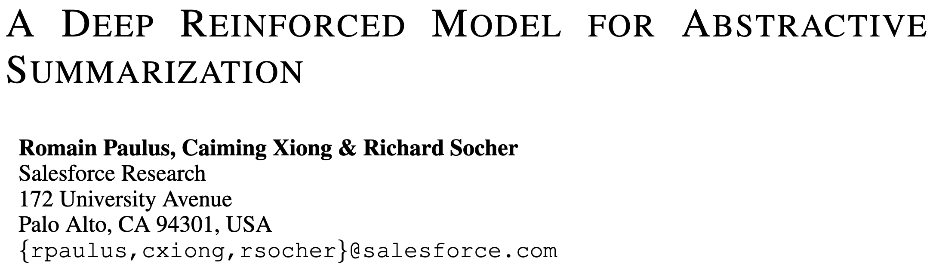
SECOND Paper
[Paulus et al., 2017]

Slide 24
AIM of the paper
Solve the repetition problem
Alleviate exposure bias

Slide 25
Exposure bias
Consider the sentence “Two people running …”
The network knows ground truth during training, but not testing
Notes:
The model makes a mistake without teacher forcing

Slide 26
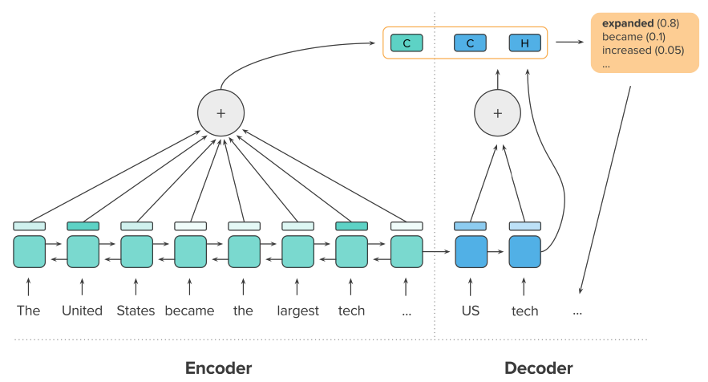
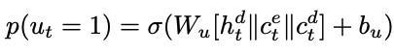
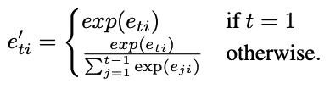
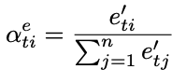
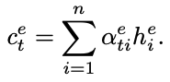
Neural intra-attention model
Notes:
Mention how the copy mechanism uses labels here and is not latent like in the previous paper

Slide 27
Avoiding repetition
Intra temporal attention was a direct way of avoiding repetition
They also ensure that no two trigrams in the produced summaries are the same (engineering)

Slide 28
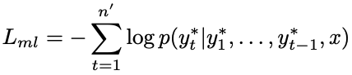
Loss functions: Teacher Forcing
T1
T2
T3
T4
We
Will
Not
Will
<START>
We
Will
We
Sentence: We will we will rock you

Slide 29
Loss functions: policy learning
Why not just optimize for the rouge metric?
The issue is that it is a discrete metric

Slide 30
Why is discrete a problem?
T1
T2
T3
T4
Consider an NLP task in which the output vocabulary is 2. Say we only care about how many times the model produces the word “We”.
Any ideas for loss functions?
We
Will
We
Will
Just define a binary loss at each time step!
<START>
We
Will
We

Slide 31
Why is discrete a problem?
T1
T2
T3
T4
We
Will
We
Will
Can you think of an equivalent and more natural way to define the loss function?
Just count the number of times “We” is produced!
Note that this is a global metric
<START>
We
Will
We

Slide 32
Additional Exercise
Can you think of a way to convert rouge to a differentiable loss function?

Slide 33
Loss functions: policy learning
Use rouge score as rewards
Is a rouge score of 20 good?
We need a baseline to tell us how good a given sentence is

Slide 34
Loss functions: Hybrid
Optimizing only for rouge will degrade the grammar and the structure of sentences
Combine both the objectives for the best of both worlds

Slide 35
Datasets
CNN/Daily Mail and New York Times
New York Times has shorter and more abstract summaries

Slide 36
Evaluation Metrics
Rouge
Human evaluation

Slide 37
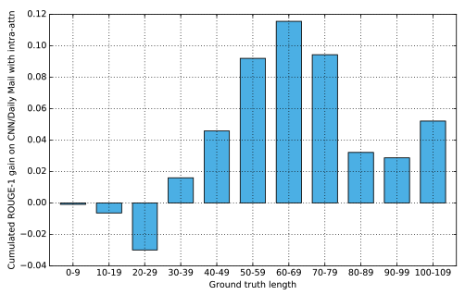
Results

Slide 38
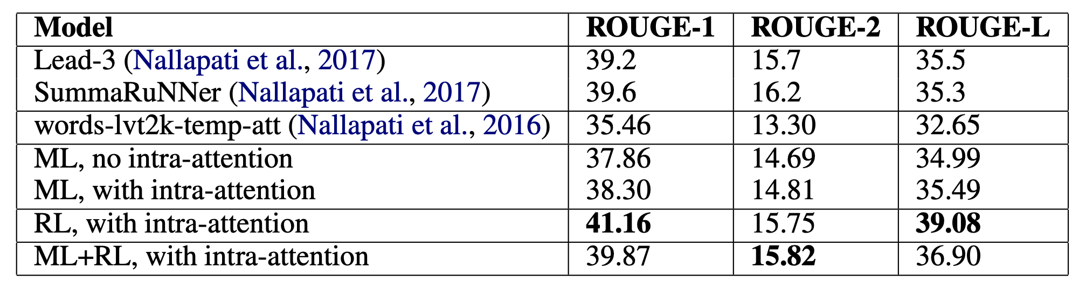
Results
CNN/Daily Mail

Slide 39
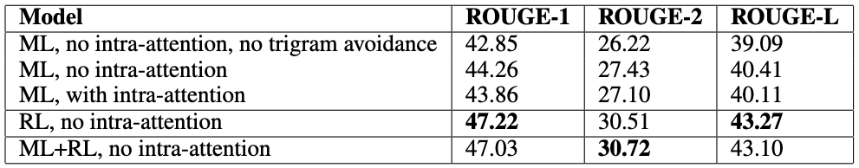
Results
New York Times

Slide 40
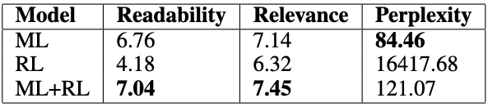
Results
Human Evaluation

Slide 41
Post-lecture Questions
What are 3 main problems of directly applying sequence-to-sequence attentional model (with a maximum-likelihood training objective) to abstractive summarization? How did these two papers tackle these problems respectively?
Repetition
Repetition
Factual Errors
Exposure Bias

Slide 42
Post-lecture Questions
In (Paulus et al, 2018), why is it a good idea to combine both supervised word prediction and reinforcement learning (RL)? Does RL-only training work better than ML training in terms of both automatic and human evaluation?
We care both about the ROUGE score, and the grammar/structure of the sentence

Slide 43
In Summary (No pun intended)
The evaluation metrics are not very strong for the tasks
Copying words almost always helps
There is a need for better loss functions

Slide 44
References
[See et al., 2017] See, Abigail, Peter J. Liu, and Christopher D. Manning. "Get to the point: Summarization with pointer-generator networks." arXiv preprint arXiv:1704.04368 (2017).
[Romain et al., 2017] Paulus, Romain, Caiming Xiong, and Richard Socher. "A deep reinforced model for abstractive summarization." arXiv preprint arXiv:1705.04304 (2017).
[Allahyari et al., 2017] Allahyari, Mehdi, et al. "Text summarization techniques: a brief survey." arXiv preprint arXiv:1707.02268 (2017).
[rush et al., 2015] Rush, Alexander M., Sumit Chopra, and Jason Weston. "A neural attention model for abstractive sentence summarization." arXiv preprint arXiv:1509.00685 (2015).

Slide 45
References
[chopra et al., 2016] Chopra, Sumit, Michael Auli, and Alexander M. Rush. "Abstractive sentence summarization with attentive recurrent neural networks." Proceedings of the 2016 Conference of the North American Chapter of the Association for Computational Linguistics: Human Language Technologies. 2016.
[nallapati et al., 2016] Nallapati, Ramesh, Feifei Zhai, and Bowen Zhou. "Summarunner: A recurrent neural network based sequence model for extractive summarization of documents." Thirty-First AAAI Conference on Artificial Intelligence. 2017.

Slide 46
Paper 1 - Issues
Coverage vectors should not have been un-normalized
All <unk> tokens should not be treated the same

Slide 47
Paper 1: Alternatives that were tried
Using temporal Attention instead of Coverage Mechanism (Explain what temporal Attention is)
Using a GRU to update the Coverage vector instead of a simple Sum
Using another distribution instead of the attention values to copy words
Using the coverage loss from the beginning

Slide 48
Paper 1: Design choices
Smaller Vocabulary is used because the network can explicitly copy
Word embeddings are learned from scratch
The documents are truncated to 400 tokens
The lengths of the documents is even smaller when training begins (connect this to the lead-3 baseline)
The coverage loss (which is given equal weightage) is only added at the end of the training

Slide 49
Paper 2: Neural intra-attention model
Token generation and pointer is different in this paper
The copy mechanism is used either when UNK tokens exists, or when a named entity is generated
Weight sharing between embedding layers and decoder output layer

